Slide 1

WEB DEVELOPMENT
E-COMMERCE WEBSITE
Presented By : M. Pooja
Department : B. Tech (Artificial Intelligence & Data Science)
College : G.K.M College Of Engineering and Technology.

Slide 2
Introduction
E-commerce means buying and selling products online.
A well-designed website is essential for user experience and business success.
Web development covers:
Frontend (UI/UX)
Backend (Logic & Database)
Payment Integration
Goal: To build a responsive, secure, and feature-rich online shopping website.

Slide 3
Features of website
User-Friendly Interface – Easy navigation, search, and product browsing experience.
Product Catalog – Organized listing of products with descriptions, images, and prices.
Shopping Cart – Allows users to add, view, and manage products before checkout.
Secure Payment Gateway – Supports multiple payment methods with secure transactions.
User Registration & Login – Personalized experience with order tracking and history.
Search & Filter Options – Helps users quickly find relevant products.
Responsive Design – Mobile and desktop-friendly for a smooth experience across devices.
Customer Reviews & Ratings – Builds trust and helps in decision-making.
Order Management System – For tracking orders, returns, and delivery updates.
Admin Dashboard – For managing inventory, users, orders, and analytics.

Slide 4
Page structure
Page | File Name | Purpose
🏠 Home | index.html | Main landing page
🛍️ Shop | shop.html | Product listings with filters
📄 Product Detail | product.html | Individual product info
🛒 Cart | cart.html | View/edit items in cart
💳 Checkout | checkout.html | Enter address, payment, place order
👤 Account | account.html | User profile, order history
🔐 Login/Sign Up | login.html / signup.html | User authentication
📞 Contact | contact.html | Contact form, support info
ℹ️ About | about.html | About the company

Slide 5
Home page
Header with logo and navigation links (Home, Products, Cart, Contact).
Hero section with a welcome message, tagline, and a call-to-action button linking to the Products page.
Featured products preview showcasing 3–4 top items with image, name, price, and "Buy Now" or "View More" button.
Benefits section showing key highlights (e.g., Free Delivery, Secure Payments, Easy Returns).
About section briefly introducing your store or brand.
Newsletter signup (optional) for collecting visitor emails.
Footer with useful links, copyright, and social media.

Slide 6
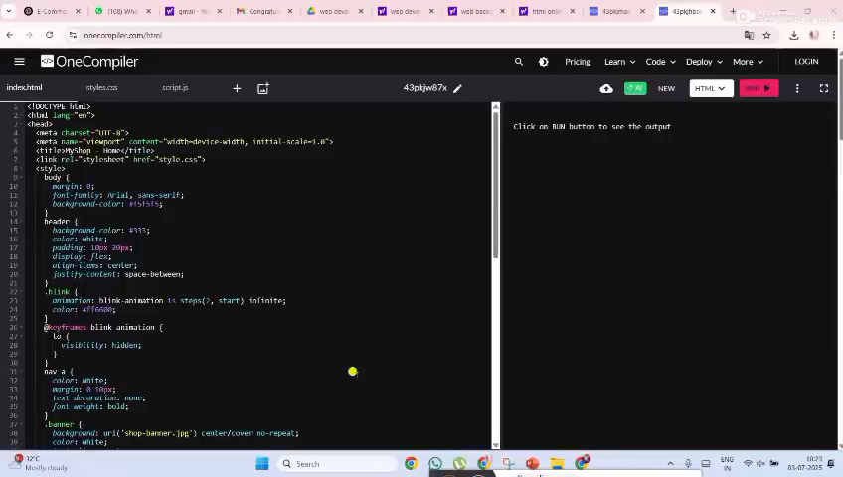

Slide 7
Product page
Header – Logo and navigation bar (same as home page).
Product Grid – Cards displaying image, name, price, and “Add to Cart” button.
Optional Filters – Category or price filters for better browsing.
Search Bar – For finding products by name (with JavaScript).
Cart Icon – Shows number of items in cart, links to cart.html.
Footer – Contact info, social links, and copyright.

Slide 8
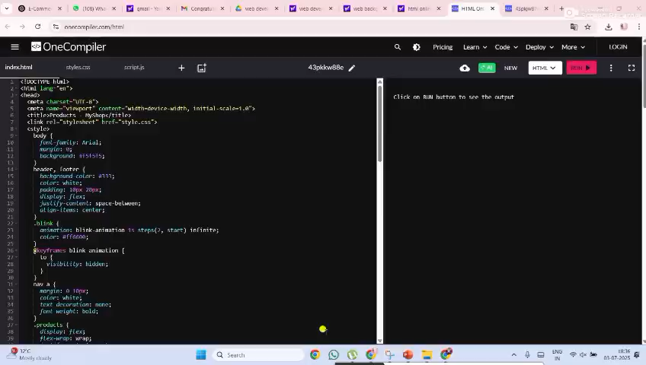

Slide 9
Cart page
Header – Logo and navigation bar (same as other pages).
Cart Item List – Shows all added products with:
Product image and name
Price and quantity
“Remove” button for each item
Quantity Controls – Buttons or inputs to increase/decrease quantity.
Total Price Section – Displays subtotal and grand total.
Checkout Button – Simulates purchase (can show a confirmation popup or message).
Empty Cart Message – Shown if no items are added.
Footer – Consistent with the rest of the site.

Slide 10
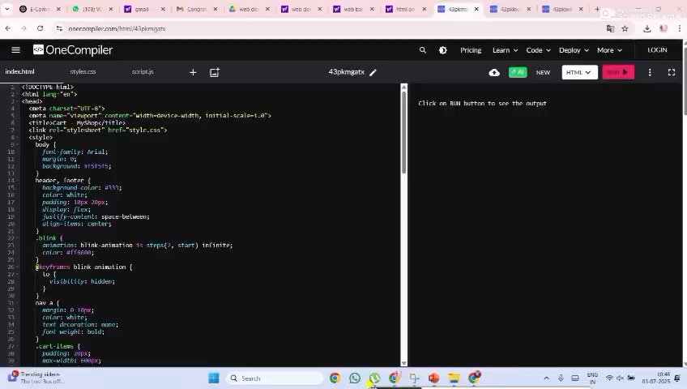

Slide 11
Local storage
🛍️ Project Name – Online Shopping Platform / E-Commerce Store
📄 Technology Used – HTML, CSS, JavaScript, Local Storage (or optionally backend tech)
💾 Local Storage Use – Save cart data without backend
🎯 Goal – Provide users a simple and efficient online shopping experience
📈 Output – Interactive frontend website with real-time cart updates
🚀 Deployment – Can be hosted using GitHub Pages / Netlify / Vercel
👥 Users – Customers can browse, add to cart, and simulate checkout
✅ Conclusion – A functional, beginner-friendly e-commerce frontend using core web technologies

Slide 12
Final output
E-Commerce Website Using HTML, CSS, JavaScript & Local Storage
Project Overview:
An interactive, front-end e-commerce website that allows users to browse products, view details, add to cart, and simulate checkout using HTML, CSS, JavaScript, and Local Storage.
Local Storage Usage:
Products added to cart are stored in the browser's local storage
Data is retrieved to populate the cart and checkout pages
Enables a functional cart experience without a database

Slide 13
Page Name | File Name | Purpose
Home | index.html | Welcome banner, featured products
Shop | shop.html | Product listing with filters
Product Detail | product.html | Detailed view of a product
Cart | cart.html | View and manage selected items
Checkout | checkout.html | Shipping info, order summary
Login / Signup | login.html / signup.html | User authentication
Contact/About | contact.html, about.html | Info and support
Key features:
User-friendly layout with responsive design
Product listings and dynamic detail view
Add to Cart functionality using Local Storage
Cart data persists across sessions
Simple navigation bar and footer across all pages
Simulated checkout page (no backend)

Slide 14

Sample Products Included:
Smartphone X1 – ₹12,999
Wireless Headphones – ₹2,499
Running Shoes – ₹1,799
Smart Watch – ₹3,999
Laptop Pro 15" – ₹45,000
Travel Backpack – ₹999
Cart auto-loads 3 items for demo if it's initially empty.
Technology Stack:
HTML for structure
CSS for styling
JavaScript for interactivity
Local Storage for cart database (client-side)

Slide 15
Deployment
Deployment Platforms:
✅ GitHub Pages – Best for static sites, free, version-controlled.
✅ Netlify – Easiest drag-and-drop method with instant hosting.
🧪 Vercel – Developer-friendly, ideal if backend or advanced features are needed later.
GITHUB LINK:
https://github.com/mpooja16/ecommerce-site.git

Slide 16
Conclusion
The e-commerce website project successfully demonstrates how core web technologies—HTML, CSS, JavaScript, and Local Storage—can be used to create a fully functional online shopping experience. Users can easily browse products, view details, manage their cart, and simulate a checkout process.
This project showcases essential features of modern e-commerce platforms such as product listings, cart management, and responsive design—all without the need for a backend. It lays a strong foundation for future development, including payment integration, user authentication, and database connectivity.
Overall, the project provides valuable hands-on experience in front-end web development and simulates real-world e-commerce functionality in a simplified, beginner-friendly environment

